Slide 1
ALU with Built-In Self-Test (BIST), Power Gating, and Dynamic Voltage & Frequency Scaling (DVFS) Optimization
Course: CMPE 630 – Digital IC Design
Instructor: Dr. Zuzak Michael
Lab Section: 01
Milestone 1
April 14, 2025
Prepared by: Gloria Mbaka

Slide 2
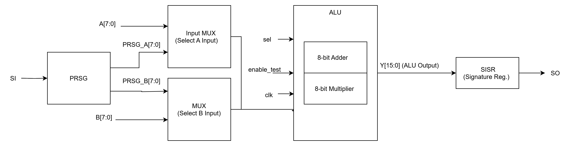
Overall Block Diagram
Figure 1: Block diagram of the ALU with Built-In Self-Test (BIST) integration. The Pseudo-Random Sequence Generator (PRSG) supplies randomized test inputs through 2-to-1 multiplexers, allowing selection between normal operation and test mode. The ALU performs either addition or multiplication based on the control signal sel. The result is compressed by the Single Input Signature Register (SISR) into a compact signature, which is scanned out via SO for verification.

Slide 3
Block Diagram Legend
Symbol/Label | Description
A[7:0] | 8-bit external input A to ALU
B[7:0] | 8-bit external input B to ALU
PRSG | Pseudo-Random Sequence Generator; generates 8-bit test values for A and B
SI | Serial Input (Scan In) to load seed into PRSG during test mode
MUX (A/B) | 2-to-1 MUXes select between normal inputs and PRSG outputs
enable_test | Control signal: 1 = use PRSG inputs and enable SISR
sel | Control signal: 0 = Adder, 1 = Multiplier in ALU
clk | Clock signal for synchronous elements (PRSG, SISR, ALU if sequential)
ALU | Arithmetic Logic Unit – executes either A + B or A × B
8-bit Adder | Ripple-carry or carry-lookahead adder using standard cells
8-bit Multiplier | Array or shift-add style multiplier using logic gates
Y[15:0] | 16-bit output from ALU (for mult and add)
SISR | Single Input Signature Register – compresses output Y to a small signature
SO | Scan Out – the final compressed signature for comparison to golden sig

Slide 4
Major Component – ALU (Adder + Multiplier)
Adder: 8-bit ripple-carry adder from Lab 8 using standard cells (AND, XOR, INV)
Multiplier: New 8-bit unsigned array multiplier built using AND and adder stages
MUX: Chooses between Adder and Multiplier output using sel bit
Output: Y[15:0]

Slide 5
Major Component – PRSG + MUX
PRSG (Pseudo-Random Sequence Generator):
9-bit Galois LFSR
Used to generate randomized test inputs
Input MUXes:
Two 2-to-1 MUXes select between external A/B and PRSG outputs
Controlled by enable_test signal

Slide 6
Major Component – SISR
SISR (Single Input Signature Register):
6-bit register with feedback XOR logic
Shifts in 1-bit responses from ALU output (e.g., parity or bitwise XOR of Y)
Final value is compared to golden signature for pass/fail validation

Slide 7
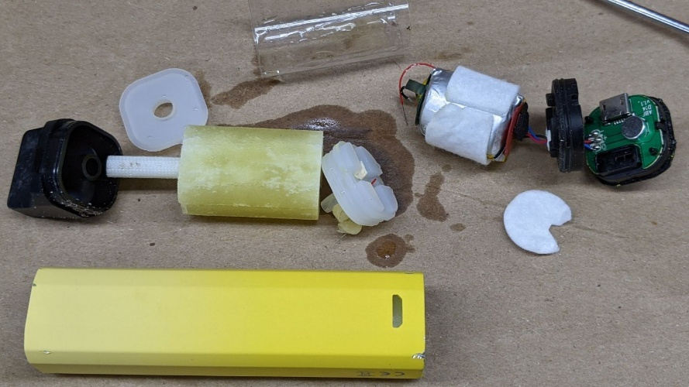
E-Liquid Reservoir
Plastic Disk
Battery and Coil Assembly
White Silicone Seal
Plastic Cylinder
Airflow Sensor and LED Unit
Mouthpiece
Outer Casing

Slide 8
Optimization – Power Gating and DVFS
Goal: Save power and improve energy efficiency using multiple strategies
Power Gating Method:
Use sleep transistors to cut VDD to inactive blocks (e.g., Multiplier, PRSG, SISR)
Control logic disables power to idle blocks to reduce leakage
DVFS Method:
Adjust operating voltage and frequency dynamically based on workload
Lower frequency/voltage for test mode; higher for performance-critical operations
Why Combine Power Gating and DVFS:
Power gating reduces static/leakage power during idle time
DVFS reduces dynamic power based on activity level
Together, these techniques allow fine-grained control over power and performance tradeoffs, helping to meet timing and energy constraints across different operating modes
This combination aligns with ongoing research into adaptive low-power design, and provides a foundation for exploring DVFS schemes in dissertation-level investigations

Slide 9
THANK YOU

